Slide 1
File Allocation

Slide 2
Introduction
File
A file is a named collection of related information that is recorded on secondary storage such as magnetic disks, magnetic tapes and optical disks. In general, a file is a sequence of bits, bytes, lines or records whose meaning is defined by the files creator and user.
File Structure
A File Structure should be according to a required format that the operating system can understand.
A file has a certain defined structure according to its type.
A text file is a sequence of characters organized into lines.
A source file is a sequence of procedures and functions.
An object file is a sequence of bytes organized into blocks that are understandable by the machine.
When operating system defines different file structures, it also contains the code to support these file structure. Unix, MS-DOS support minimum number of file structure.

Slide 3
Types of files
File type refers to the ability of the operating system to distinguish different types of file such as text files source files and binary files etc. There are different types of files
Ordinary files
Directory files
Special files

Slide 4
File Allocation Methods
The main idea behind allocation is effective utilization of file space and fast access of the files. The allocation methods define how the files are stored in the disk blocks. There are three main disk space or file allocation methods.
Contiguous Allocation
Linked Allocation
Indexed Allocation

Slide 5
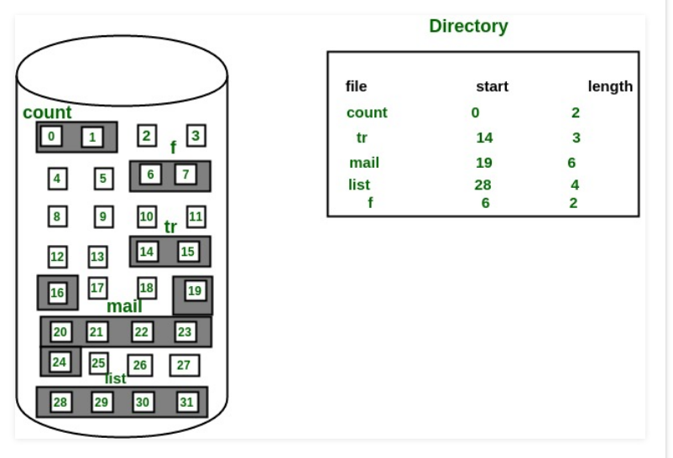
Contiguous Allocation

Slide 6
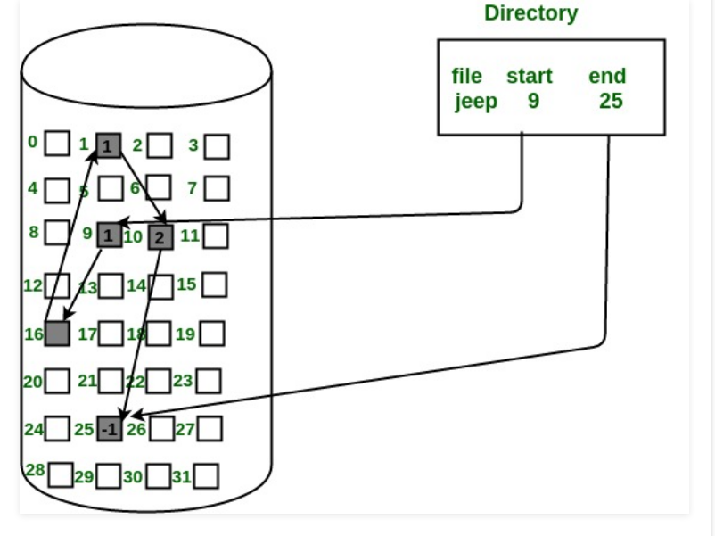
Linked Allocation

Slide 7
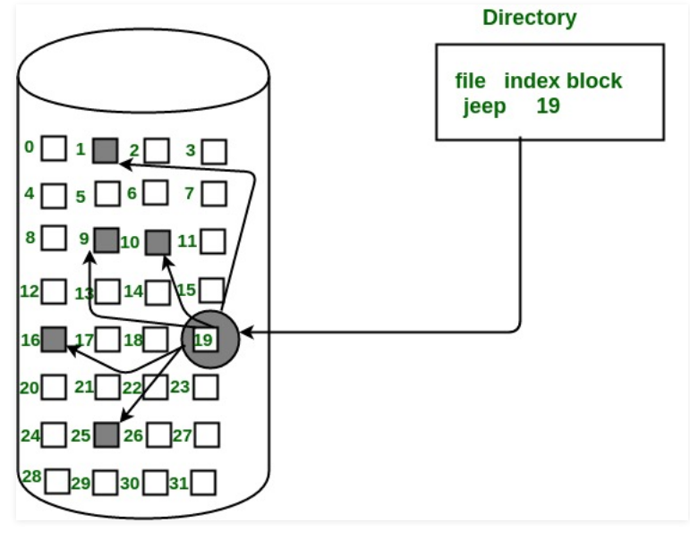
Indexed Allocation

